Slide 2
David and his men reached Ziklag on the third day. Now the Amalekites had raided the Negev and Ziklag. They had attacked Ziklag and burned it, and had taken captive the women and everyone else in it, both young and old. They killed none of them, but carried them off as they went on their way.
1 Samuel 30:1-6 (NIV)

Slide 3
When David and his men reached Ziklag, they found it destroyed by fire and their wives and sons and daughters taken captive. So David and his men wept aloud until they had no strength left to weep. David’s two wives had been captured—Ahinoam of Jezreel and Abigail, the widow of Nabal of Carmel.
1 Samuel 30:1-6 (NIV)

Slide 4
David was greatly distressed because the men were talking of stoning him; each one was bitter in spirit because of his sons and daughters. But David found strength in the Lord his God.
1 Samuel 30:1-6 (NIV)

Slide 6
Hear my cry for help, my King and my God, for to you I pray.
Psalm 5:2
Hear me, Lord, my plea is just; listen to my cry.
Hear my prayer – it does not rise from deceitful lips.
Psalm 17:1
Hear my prayer, O God; listen to the words of my mouth.
Psalm 54:2

Slide 7
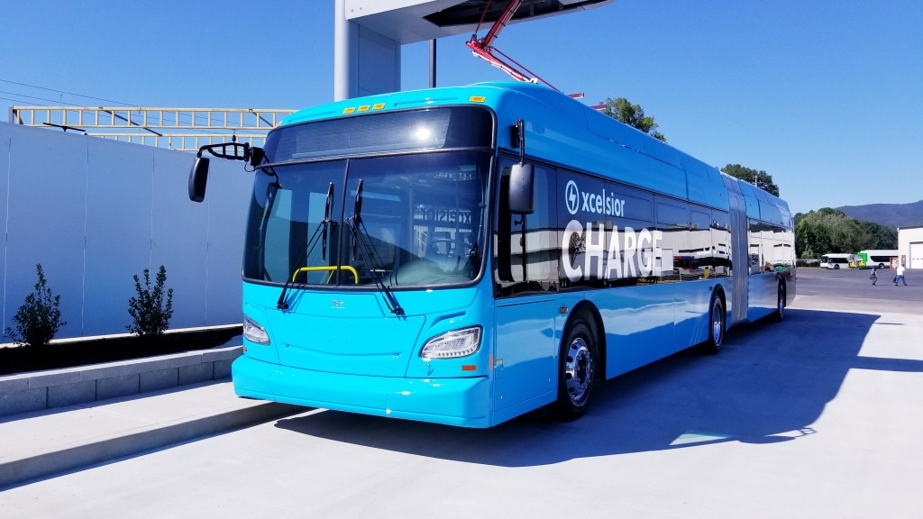

Slide 8
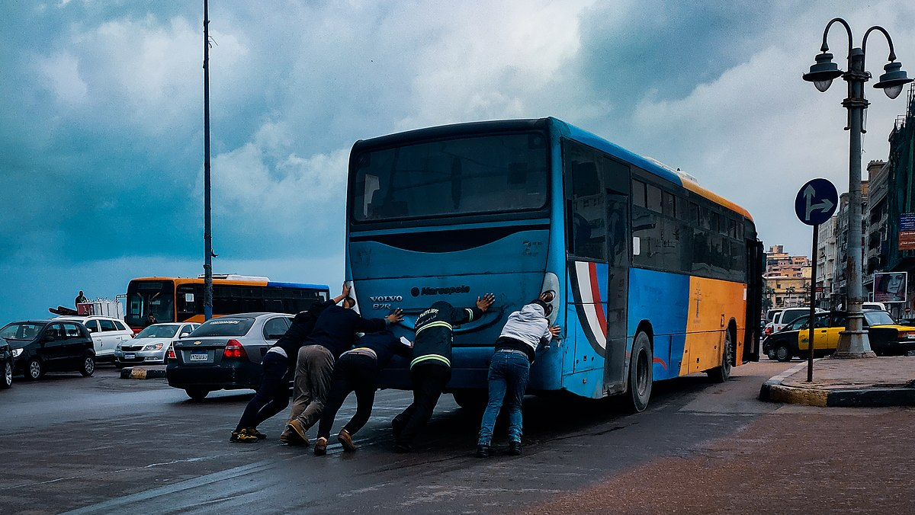

Slide 9
Honest Appraisals
Admission of weakness/need

Slide 11
Help, Lord, for no one is faithful anymore; those who are loyal have vanished from the human race.
Psalm 12:1

Slide 12
Turn to me and be gracious to me, for I am lonely and afflicted.
Psalm 25:16

Slide 13
But you, Sovereign Lord, help me for your name’s sake; out of the goodness of your love, deliver me. For I am poor and needy, and my heart is wounded within me. I fade away like an evening shadow; I am shaken off like a locust. My knees give way from fasting; my body is thin and gaunt. I am an object of scorn to my accusers; when they see me, they shake their heads. Help me, Lord my God; save me according to your unfailing love.
Psalm 109:21-26

Slide 14
Honest Appraisals
Admission of weakness/need
Lament

Slide 15
I am worn out from my groaning. All night long I flood my bed with weeping and drench my couch with tears.
Psalm 6:6

Slide 16
Be merciful to me, Lord, for I am in distress; my eyes grow weak with sorrow, my soul and body with grief.
Psalm 31:9

Slide 17
My heart is in anguish within me; the terrors of death have fallen on me. Fear and trembling have beset me; horror has overwhelmed me. I said, “Oh, that I had the wings of a dove! I would fly away and be at rest.”
Psalm 55:4-6

Slide 18
Hopeful Ascent

Slide 19
Hopeful Ascent
God’s Word

Slide 20
And the words of the Lord are flawless…
Psalm 12:6a
The law of the Lord is perfect, refreshing the soul.
Psalm 19:7a
The precepts of the Lord are right, giving joy to the heart.
Psalm 19:8a

Slide 22
Hopeful Ascent
God’s Word
Praise

Slide 23
I will give thanks to you, Lord, with all my heart; I will tell of all your wonderful deeds.
Psalm 9:1
I will praise the Lord, who counsels me…
Psalm 16:7a
I will extol the Lord at all times; his praise will always be on my lips.
Psalm 34:1

Slide 24
Praise the Lord, my soul; all my inmost being, praise his holy name. Praise the Lord, my soul, and forget not all his benefits…
Psalm 103:1-2

Slide 25
From the Lord comes deliverance.
Psalm 3:8a
God is a righteous judge…
Psalm 7:11a
The Lord is a refuge for the oppressed…you, Lord, have never forsaken those who seek you.
Psalm 9:9-10

Slide 26
Good and upright is the Lord…
Psalm 25:8a
He lifted me out of the slimy pit, out of the mud and mire; he set my feet on a rock and gave me a firm place to stand. He put a new song in my mouth, a hymn of praise to our God.
Psalm 40:2-3a

Slide 28
Praise includes our emotions, thoughts, and adoration of God, personally packaged and delivered to Jesus.
Dick Brogden

Slide 29
Hopeful Ascent
God’s Word
Praise
Song

Slide 30
I will sing the praises of the name of the Lord Most High.
Psalm 7:17b
I will sing and make music with all my soul.
Psalm 108:1b

Slide 32
Truly my soul finds rest in God; my salvation comes from him.
Psalm 62:1

