Slide 2
Pastoral ministry might become more difficult
but
Jesus will renew you day by day

Slide 3
The Father of Compassion
The God of all Comfort

Slide 4
For what we preach is not ourselves, but Jesus Christ as Lord, and ourselves as your servants for Jesus’ sake. For God, who said, “Let light shine out of darkness,” made his light shine in our hearts to give us the light of the knowledge of God’s glory displayed in the face of Christ.
2 Corinthians 4:5-18 (NIV)

Slide 5
But we have this treasure in jars of clay to show that this all-surpassing power is from God and not from us. We are hard pressed on every side, but not crushed; perplexed, but not in despair; persecuted, but not abandoned; struck down, but not destroyed. We always carry around in our body the death of Jesus, so that the life of Jesus may also be revealed in our body.
2 Corinthians 4:5-18 (NIV)

Slide 6
For we who are alive are always being given over to death for Jesus’ sake, so that his life may also be revealed in our mortal body. So then, death is at work in us, but life is at work in you.
2 Corinthians 4:5-18 (NIV)

Slide 7
It is written: “I believed; therefore I have spoken.” Since we have that same spirit of faith, we also believe and therefore speak, because we know that the one who raised the Lord Jesus from the dead will also raise us with Jesus and present us with you to himself.
2 Corinthians 4:5-18 (NIV)

Slide 8
All this is for your benefit, so that the grace that is reaching more and more people may cause thanksgiving to overflow to the glory of God. Therefore we do not lose heart. Though outwardly we are wasting away, yet inwardly we are being renewed day by day.
2 Corinthians 4:5-18 (NIV)

Slide 9
For our light and momentary troubles are achieving for us an eternal glory that far outweighs them all. So we fix our eyes not on what is seen, but on what is unseen, since what is seen is temporary, but what is unseen is eternal.
2 Corinthians 4:5-18 (NIV)

Slide 10
Observations
1. The connection between glory and death

Slide 11
For God, who said, “Let light shine out of darkness,” made his light shine in our hearts to give us the light of the knowledge of God’s glory displayed in the face of Christ.
But we have this treasure in jars of clay to show that this all-surpassing power is from God and not from us. We are hard pressed on every side, but not crushed; perplexed, but not in despair; persecuted, but not abandoned; struck down, but not destroyed. We always carry around in our body the death of Jesus, so that the life of Jesus may also be revealed in our body. For we who are alive are always being given over to death for Jesus’ sake, so that his life may also be revealed in our mortal body. So then, death is at work in us, but life is at work in you.
It is written: “I believed; therefore I have spoken.” Since we have that same spirit of faith, we also believe and therefore speak, because we know that the one who raised the Lord Jesus from the dead will also raise us with Jesus and present us with you to himself. All this is for your benefit, so that the grace that is reaching more and more people may cause thanksgiving to overflow to the glory of God.
Therefore we do not lose heart. Though outwardly we are wasting away, yet inwardly we are being renewed day by day. For our light and momentary troubles are achieving for us an eternal glory that far outweighs them all. So we fix our eyes not on what is seen, but on what is unseen, since what is seen is temporary, but what is unseen is eternal.

Slide 12
For God, who said, “Let light shine out of darkness,” made his light shine in our hearts to give us the light of the knowledge of God’s glory displayed in the face of Christ.
But we have this treasure in jars of clay to show that this all-surpassing power is from God and not from us. We are hard pressed on every side, but not crushed; perplexed, but not in despair; persecuted, but not abandoned; struck down, but not destroyed. We always carry around in our body the death of Jesus, so that the life of Jesus may also be revealed in our body. For we who are alive are always being given over to death for Jesus’ sake, so that his life may also be revealed in our mortal body. So then, death is at work in us, but life is at work in you.
It is written: “I believed; therefore I have spoken.” Since we have that same spirit of faith, we also believe and therefore speak, because we know that the one who raised the Lord Jesus from the dead will also raise us with Jesus and present us with you to himself. All this is for your benefit, so that the grace that is reaching more and more people may cause thanksgiving to overflow to the glory of God.
Therefore we do not lose heart. Though outwardly we are wasting away, yet inwardly we are being renewed day by day. For our light and momentary troubles are achieving for us an eternal glory that far outweighs them all. So we fix our eyes not on what is seen, but on what is unseen, since what is seen is temporary, but what is unseen is eternal.

Slide 13
Observations
The connection between glory and death
The all-sufficiency of Jesus

Slide 14
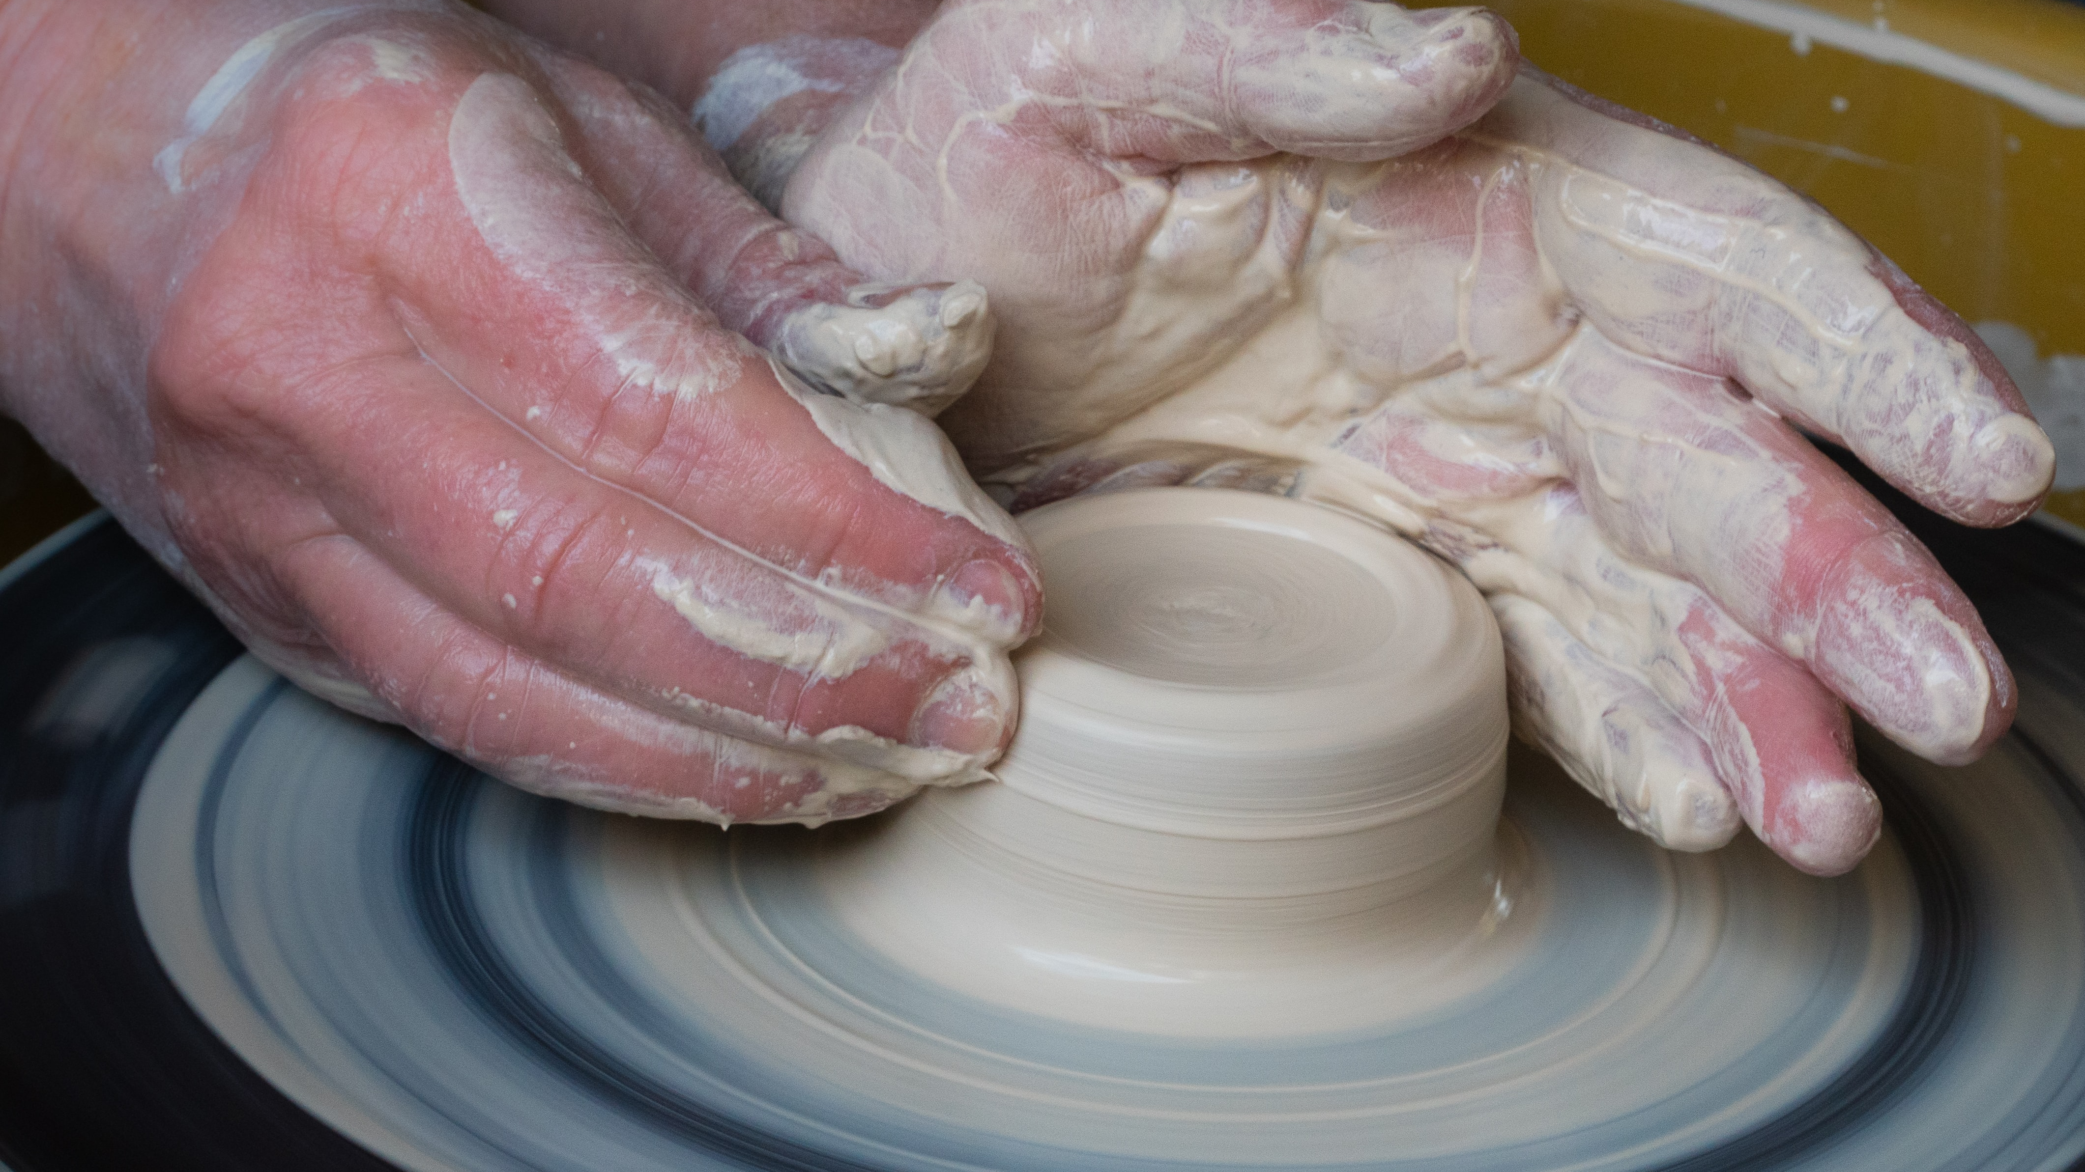

Slide 15
hard-pressed | but | not crushed
perplexed | but | not in despair
persecuted | but | not abandoned
struck down | but | not destroyed

Slide 16
Observations
The connection between glory and death
The all-sufficiency of Jesus
The need for a future-present faith

Slide 17
The world breaks everyone, and afterward, some are strong at the broken places.
Ernest Hemingway

Slide 18
Therefore we do not lose heart. Though outwardly we are wasting away, yet inwardly we are being renewed day by day. For our light and momentary troubles are achieving for us an eternal glory that far outweighs them all. So we fix our eyes not on what is seen, but on what is unseen, since what is seen is temporary, but what is unseen is eternal.
2 Corinthians 4:16-18 (NIV)

Slide 19
A moment is long if we look at the things around us; but once we have raised our minds to heaven a thousand years begins to be like a moment.
John Calvin

Slide 20
Whatever we long for and expect in the future inevitably determines how we live in the present. Hope and its desires are the engine the drives us…Only the ‘eternal glory’ can outweigh the burdens of this world…If what we consider to be good remains identified with what this world has to offer…our lives will inevitably become worldly…
Scott Hafemann

Slide 21
Our hopes determine our habits…we are a future-determined people. In order not to lose heart now, the world to come, not this one, must captivate our minds. Only those who are heavenly minded are any earthly good.
Scott Hafemann

